Slide 1

Task 2
Predicting customer buying behaviour
Build a predictive model to understand factors that influence buying behaviouR
29/08/2023

Slide 2
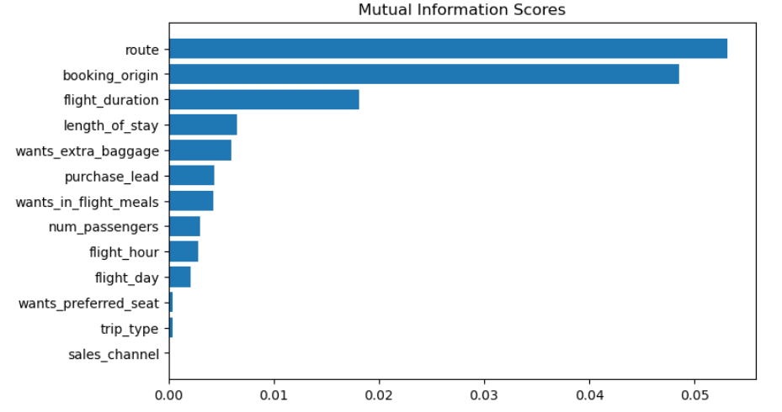
INSIGHTS FROM CUSTOMER REVIEWS
We can observe that the following features have the most significant impact on 'booking_complete':
1) Route
2) Booking_origin
3) Flight_duration
4) Wants_extra_baggage
5) Length_of_stay
6) Wants_extra_baggage
These features play a crucial role in customers' decisions when booking a flight.
Therefore, it is essential for British Airways to pay close attention to these aspects.
Ensuring that these factors are up-to-date and satisfactory can greatly influence the booking decisions of passengers.
Airlines should prioritize maintaining and optimizing these aspects to enhance the overall booking experience.

Slide 3
INSIGHTS FROM CUSTOMER REVIEWS
For addressing this problem, I employed the Random Forest classification algorithm. Subsequently, the results obtained are as follows:
When training the model with the top six features that exert the most significant influence on bookings, it achieved an accuracy of approximately 83%. These features include route, booking origin, flight duration, wants extra baggage, length of stay, and wants in-flight meals.
When the model was trained with the top eight features that have the most impact on booking, it achieved an accuracy of nearly 84%. These selected features are route, booking origin, flight duration, wants extra baggage, length of stay, wants in-flight meals, purchase lead, and wants in-flight meals.
Finally, when all features were used for training, the model achieved an accuracy of nearly 85%.

